Slide 1
Introduction to HTML
Lecture 3

Slide 2
Forms
Most websites are interactive in that they allow the user to request information or send information to the web site
Use forms, in conjunction with some scripting language like JavaScript to get information from the user and process this information

Slide 3
Forms
The form element (<form></form>) is used to include a number of form elements together so that they can be referenced by some other code in order to read information from the user
The individual form elements are implemented using the <input /> tag and its type attribute

Slide 4
<form name="input" action="html_form_action.asp"
method="get">
Username: <input type="text" name="user"> <input type="submit" value="Submit">
</form>

Slide 5
<FORM> element attributes
ACTION: specifies where to send the form-data when a form is submitted
<form action="URL">
Possible values
An absolute URL - points to another web site (like action="http://www.example.com/example.htm")
A relative URL - points to a file within a web site (like action="example.htm")
NAME: Specifies the name of a form
TARGET: Specifies where to display the response that is received after submitting the form.

Slide 6
FORM> element attributes
METHOD: specifies how to send form-data (the form-data is sent to the page specified in the action attribute).
Two commonly used methods for a request-response between a client and server are: GET and POST.
GET - Requests data from a specified resource. GET is used to retrieve remote data
Note that query strings (name/value pairs) is sent in the URL of a GET request:
/test/demo_form.asp?name1=value1&name2=value2
POST - Submits data to be processed to a specified resource. POST is used to insert/update remote data.
Note that query strings (name/value pairs) is sent in the HTTP message body of a POST request:
POST /test/demo_form.asp HTTP/1.1 Host: w3schools.com name1=value1&name2=value2

Slide 7
Commonly Used Input Elements
Textboxes (<input type= “text” />)
Checkboxes (<input type= “checkbox” />)
Radio Buttons (<input type= “radio” />)
Buttons: (<input type= “button” />)
Password Textboxes (<input type= “password” />)
Submit Buttons (<input type= “submit” />)
Reset Buttons (<input type= “reset” />)
File (<input type="File" name="myFile“>)

Slide 8
Form Elements
<input> Element’s Properties
Type = Type of INPUT entry field.
name= Specifies the name of an <input> element
value= Specifies the value of an <input> element
checked= Button/box checked
size= Number of visible characters in text field
maxlength= Maximum number of characters accepted.

Slide 9
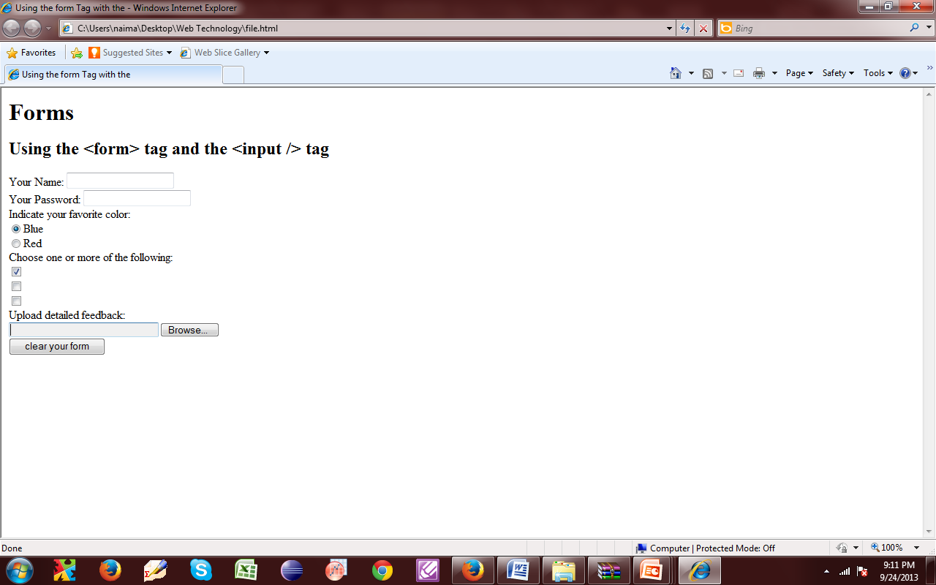

Slide 10
<html>
<head>
<title>Using the form Tag with the </title>
</head>
<body>
<h1>Forms</h1>
<h2>Using the &lt;form&gt; tag and the &lt;input /&gt; tag</h2>
<form name="feedbackfrm">
Your Name: <input type="text" /><br />
Your Password: <input type="password" /><br />
Indicate your favorite color:<br />
<input type="radio" checked="true" value="blue"/>Blue<br />
<input type="radio" value="red"/>Red<br />
Choose one or more of the following:<br />
<input type="checkbox" checked = "true" /><br />
<input type="checkbox" /><br />
<input type="checkbox" /><br />
Upload detailed feedback:<br/>
<input type="File" name="myFile" size="30“>
<input type="submit" value="submit your form" /><br />
<input type="reset" value="clear your form" /><br />
</form>
</body>
</html>

Slide 11
Using the <textarea> tag
textarea element allows larger blocks of text to be submitted
The textarea element uses the <textarea></textarea> tags
use the rows and cols attributes to set the size of the textarea

Slide 12
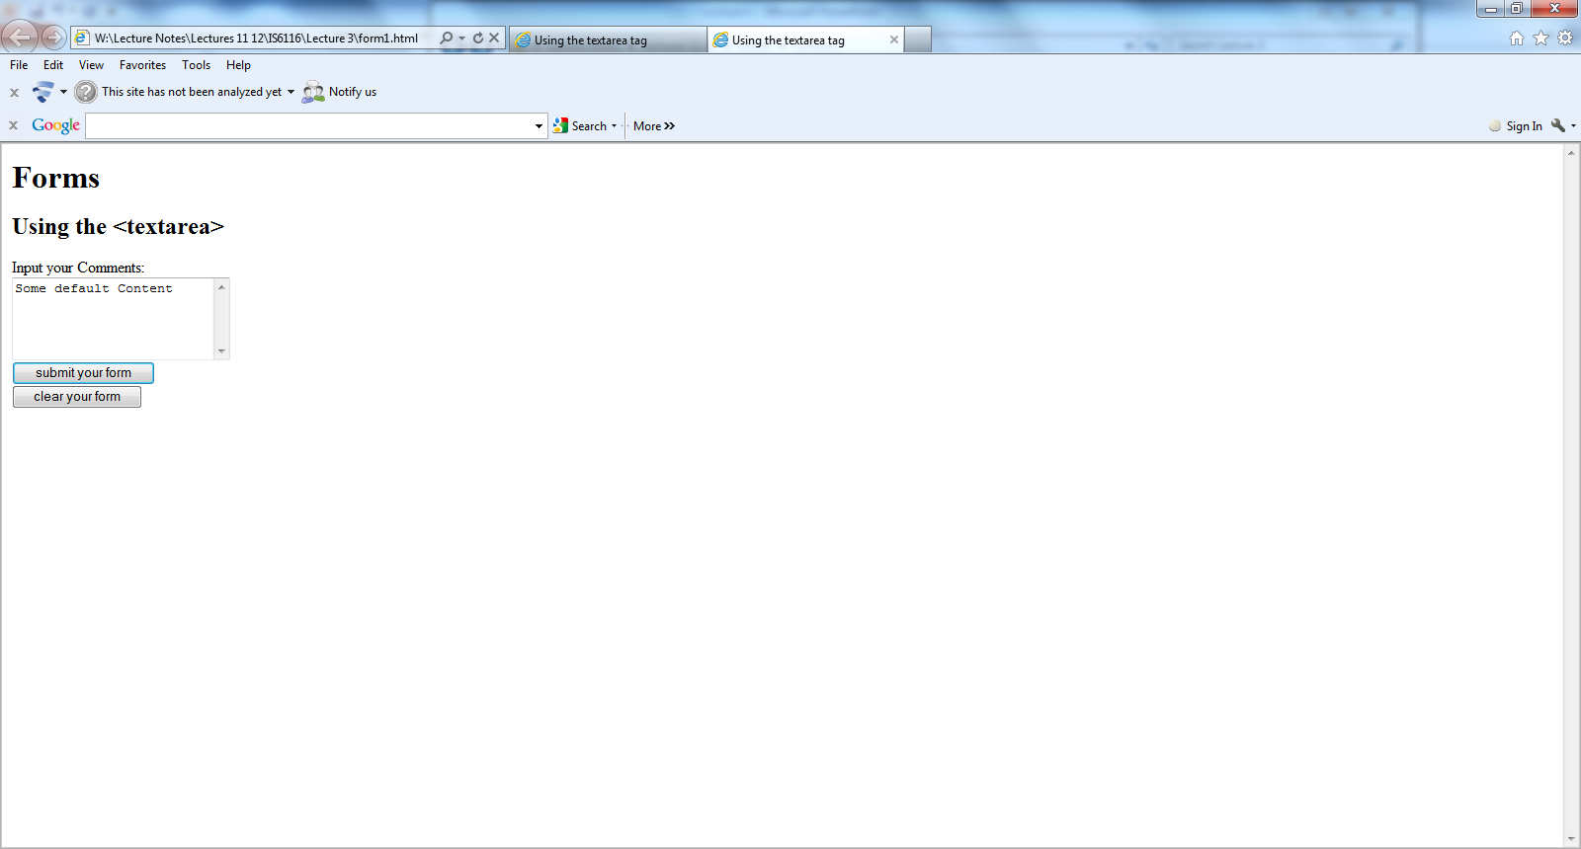

Slide 13
<html >
<head>
<title>Using the textarea tag</title>
</head>
<body>
<h1>Forms</h1>
<h2>Using the &lt;textarea&gt;</h2>
<form name="feedbackfrm">
Input your Comments:<br />
<textarea rows="5" cols="25">Some default Content</textarea><br />
<input type="submit" value="submit your form" /><br />
<input type="reset" value="clear your form" /><br />
</form>
</body
</html>

Slide 14
Other Elements used in Forms
The <select> element is used to create a drop-down list.
The <option> tags inside the <select> element define the available options in the list.

Slide 15
<body bgcolor=lightblue>
<form>
Select the cities you have visited:
<select name=“list” size=5>
<option> London</option>
<option> Tokyo</option>
<option> Paris</option>
<option> New York</option>
<option> LA</option>
<option> KL</option>
</select>
</form>
</BODY>

Slide 16
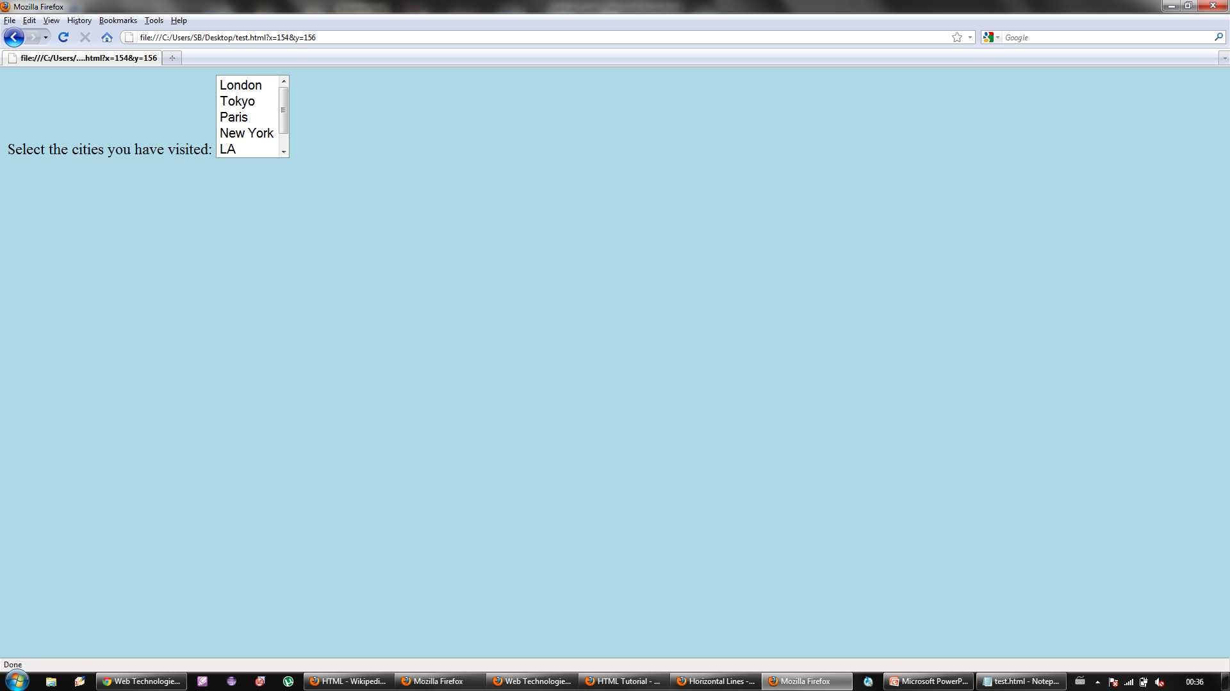

Slide 17
<HEAD> <TITLE>SELECT with Mutiple </TITLE> </HEAD>
<BODY>
<h2><font color=blue>What type of Computer do you have?</font><h2>
<FORM>
<SELECT NAME="ComputerType" size=5 multiple>
<OPTION value="IBM" > IBM</OPTION>
<OPTION value="INTEL"> INTEL</OPTION>
<OPTION value=" Apple"> Apple</OPTION>
<OPTION value="Compaq" SELECTED> Compaq</OPTION>
<OPTION value=" other"> Other</OPTION>
</SELECT>
</FORM></BODY></HTML>

Slide 18
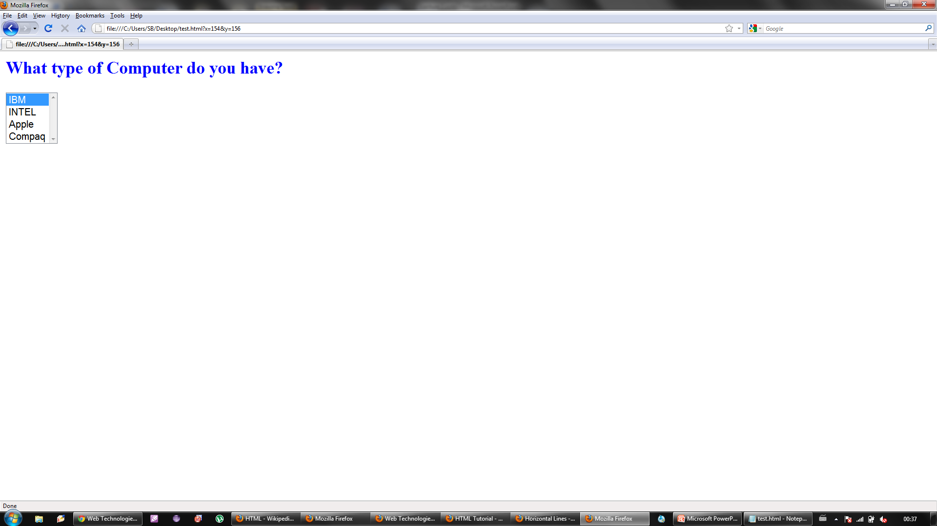

Slide 19
Cascading Style Sheets (CSS)

Slide 20
Styles Solved a Big Problem
HTML was never intended to contain tags for formatting a document.
HTML was intended to define the content of a document, like:
<h1>This is a heading</h1>
<p>This is a paragraph.</p>
Development of large web sites, where fonts and color information were added to every single page, became a long and expensive process.
To solve this problem, the World Wide Web Consortium (W3C) created CSS.
In HTML 4.0, all formatting could be removed from the HTML document, and stored in a separate CSS file.
All browsers support CSS today.

Slide 21
Cascading Style Sheets
CSS stands for Cascading Style Sheets
Styles define how to display HTML elements
Styles were added to HTML 4.0 to solve a problem
A style is a rule describing how to format a particular piece of HTML
A style sheet is a set of these canned styles
Can apply a style to text, images, or other elements on a page

Slide 22
CSS Example
body { background-color:#d0e4fe; } h1 { color:orange; text-align:center; } p { font-family:"Times New Roman"; font-size:20px; }

Slide 23
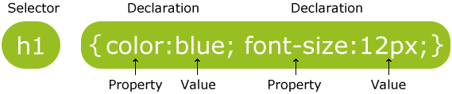
CSS Syntax
A CSS rule has two main parts: a selector, and one or more declarations:
The selector is normally the HTML element you want to style.
Each declaration consists of a property and a value.
The property is the style attribute you want to change. Each property has a value.

Slide 24
CSS Comments
Comments are used to explain your code, and may help you when you edit the source code at a later date. Comments are ignored by browsers.
A CSS comment begins with "/*", and ends with "*/", like this:
/*This is a comment*/ p { text-align:center; /*This is another comment*/ color:black; font-family:arial; }

Slide 25
CSS Id and Class
In addition to setting a style for a HTML element, CSS allows you to specify your own selectors called "id" and "class".
The id selector is used to specify a style for a single, unique element.
The id selector uses the id attribute of the HTML element, and is defined with a "#".
The style rule below will be applied to the element with id="para1":
#para1 { text-align:center; color:red; }
<p id=‘para1’> This is para 1<p>

Slide 26
CSS Id and Class
The class selector is used to specify a style for a group of elements. Unlike the id selector, the class selector is most often used on several elements.
This allows you to set a particular style for many HTML elements with the same class.
The class selector uses the HTML class attribute, and is defined with a "."
In the example below, all HTML elements with class="center" will be center-aligned:
.center {text-align:center;}
<p class=‘center’> This is para 1<p>
<p class=‘center’> This is para 2<p>
<p class=‘center’> This is para 3<p>
<p id=‘para1’> This is para 4<p>

Slide 27
Inserting Style Sheets
External style sheet
Used to apply style to many pages
Change look of entire web site by just changing one CSS
Can be written using any text editor
File should not contain any html tags
Save file with .css extension
<head> <link rel="stylesheet" type="text/css" href="mystyle.css" /> </head>
Example style sheet file
h1 {color:blue;} p {margin-left:20px;} body {background-image:url("images/back40.gif");}
defines the relationship between a document and an external resource.
.

Slide 28
Inserting Style Sheets
Internal style sheet
Used when single document has a unique style
Define internal styles in the head section of an HTML page by using <style> tab, like this:
<head> <style> h1 {color:sienna;} p {margin-left:20px;} body {background-image:url("images/back40.gif");} </style> </head>

Slide 29
Inserting Style Sheets
Inline style
Use the style attribute in the relevant tag. The style attribute can contain any CSS property, for example:
<p style="color:sienna;margin-left:20px">This is a paragraph.</p>
Looses many advantages of style sheets
Mixes content with presentation
Used sparingly

Slide 30
Multiple Style Sheets
Cascading order
What style will be used when there is more than one style specified for an HTML element?
Generally speaking we can say that all the styles will "cascade" into a new "virtual" style sheet by the following rules, where number four has the highest priority:
Browser default
External style sheet
Internal style sheet (in the head section)
Inline style (inside an HTML element)
So, an inline style (inside an HTML element) has the highest priority, which means that it will override a style defined inside the <head> tag, or in an external style sheet, or in a browser (a default value).

Slide 31
Multiple Style Sheets
If some properties have been set for the same selector in different style sheets, the values will be inherited from the more specific style sheet :
h3 { color:red; text-align:left; font-size:8pt; }
h3 { text-align:right; font-size:20pt; }
color:red; text-align:right; font-size:20pt
External
Internal
Actual Properties for h3
The color is inherited from the external style sheet and the text-alignment and the font-size is replaced by the internal style sheet.

Slide 32
Generic Containers
Currently, we know how to modify the properties of HTML tags using style sheets
But, we can only modify the tags and what they contain
Can’t modify a group of tags as one
The generic containers, <span> and <div>, allow us to group tags or words

Slide 33
<span> Tag
The span tag is useful for applying attributes to some text
ex. I love chocolate-covered espresso beans
CSS:
span.chocolate {
font-family: Times;
color: #330;
}
HTML:
I love <span class = “chocolate”> chocolate-covered espresso beans</span>

Slide 34
<span>, cont.
The attributes of <span> are:
id : the id from the style sheet
class : the class from the style sheet
lang : language of the text
dir : specifies the direction of text (ltr, rtl)

Slide 35
Div
The <div> tag defines a division or a section in an HTML document.
The <div> tag is often used to group block-elements to format them with styles.
The <div> tag defines a division of a page that is separated from other areas by line breaks.
The idea is that you can use <div> similar to <br />, but with its own formatting
<div id="header">
Specifies a unique id for an element

Slide 36
<html >
<head>
<link rel="stylesheet" type="text/css" href="cssnew.css"/>
<title>Divide Your Page</title>
</head>
<body>
<div id="container">
<div id="header">
Hello World
<!--This is where the header information is situated-->
</div><!--close #header div-->
<div id="content">
Hello World
<!--This is where the main content information is situated-->
</div><!--close #content div-->
<div id="footer">
Hello World
<!--This is where the footer information is situated -->
</div><!--close #footer div -->
</div><!--close #container div-->
</body>
</html>
#container
{
width: 550px;
background-color: #ffffff;
}
#header
{
padding: 10 20px;
background-color: #999999;
}
#content
{
padding: 10 20px;
background-color: #cccccc;
}
#footer
{
padding: 10 20px;
background-color: #999999;
}

Slide 37
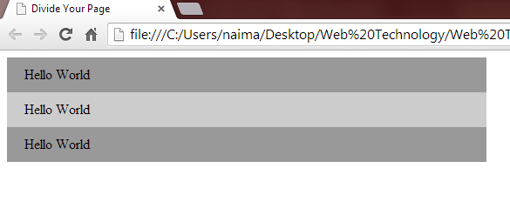

Slide 38
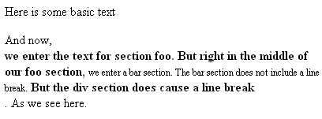
Example
<style type="text/css">
.foo {
font-weight: bold;
font-size: 1.0em;
}
.bar {
font-style: Chicago, sans;
font-weight: normal;
font-size: .75em;
}
</style>
</head>
<body>
<p>Here is some basic text</p>
And now, <div class="foo">we enter the text for section foo. But right in
the middle of our foo section, <span class="bar">we enter a bar section. The
bar section does not include a line break.</span> But the div section does
cause a line break</div>. As we see here.
Notes:
In this example, we have three styles, the default, the class foo and the class bar. So the text starts with the default because the <p> section does not include a style=“…”. After “And now,” we use <div> to start a new division using the “foo” style. Because of the <div>…</div>, this set of text has a line break before and after, and therefore “we enter” starts a new line and “line break” ends a line. In the middle of the <div>…</div> section, we have a <span>…</span> section. This section changes the style to that of “bar” but does so without introducing line breaks. So you can see “we enter a bar section” and “not include a line break” are in the “bar” style but without line breaks before or after.
In general, you are not going to want to use <div> because you don’t need to insert line breaks in the middle of text. If the text should use a different style, you can use <span>. If you want to separate the text out, the <p> tag is better because it separates the sections with an additional line break. You will experiment with these in the next exercise.
Take a look at embeddedexamplewithdivspan.html on the chapter 3 sample pages.

